Slide 1

Makrosi
Makrosa ieraksts (Recording a macro)
  Izpildīt atkārtojošas darbības automātiski
Tools / Macro / Record New Macro / Macro name: MyFirstMacro / Store macro in: This workbook / OK -> / actions / press
A1 / TimesNewRoman / 24 / Bold / Italic / RTU / Enter

Slide 2


Makro izpildīšana
Tools / Macro / Macros / Macro name: MyFirstMacro / Run

Slide 3
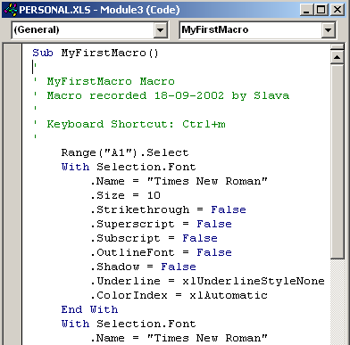
Makro rediģēšana
Tools / Macro / Macros / Macro name: MyFirstMacro / Edit
A1 / TimesNewRoman / 24 / Bold / Italic / RTU / Enter

Slide 4
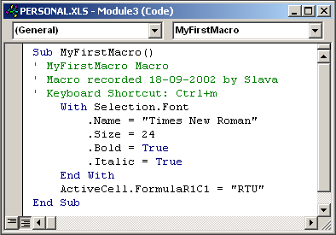
Makro rediģēšana (2)

Slide 5

Makro izpildīšana (2)
Tools / Macro / Macros / Macro name: MyFirstMacro / Run

Slide 6
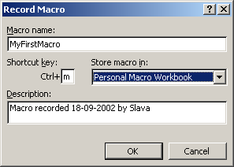
Makro izpildīšana (3)
Shortcut key:
Ctrl+
m

Slide 7
Makrosa ieraksts (2)
Relatīva adresācija
  Izpildīt Macro no tekošas pozīcijas
Tools / Macro / Record New Macro / Macro name: SecondMacro / Store macro in: This workbook / OK -> / A1 / ... / press
Relative reference

Slide 8
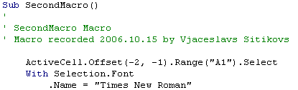
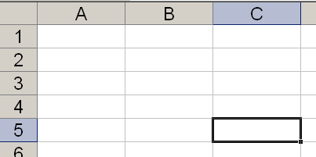
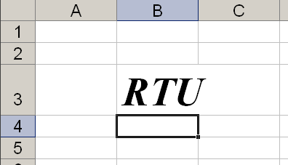
Makrosa ieraksts (3)

Slide 9
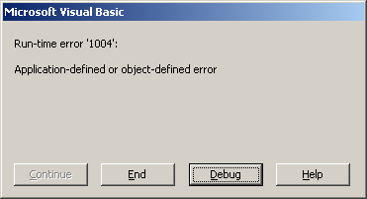
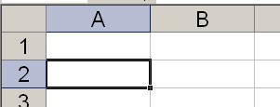
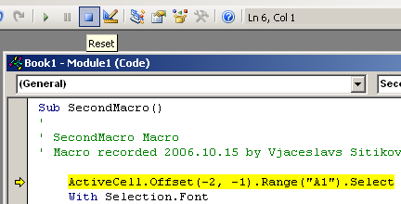
Makrosa ieraksts (4)

Slide 10
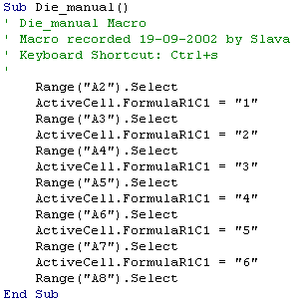
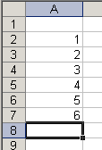
Makro tieša rakstīšana
Absolūta adresācija

Slide 11
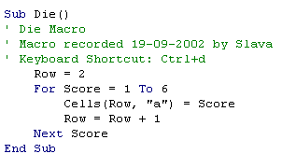
Makro tieša rakstīšana (2)
Excel VB editor
Alt+F11 / Insert / Procedure / Name: Die / Type: Sub

Slide 12
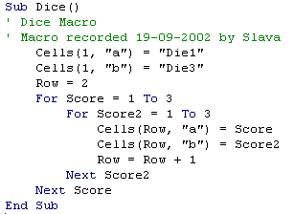
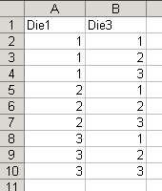
Makro tieša rakstīšana (3)
Alt+F11 / ... / Name: Dice / Type: Sub

Slide 13


User function
Alt+F11 / Insert / Module / Insert / Procedure / Name: Cubed / Type: Function

Slide 14
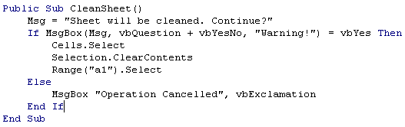
Dialodlogs

Slide 15
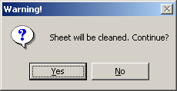
Dialodlogs (2)

Slide 16
Dialodlogs (3)

Slide 17
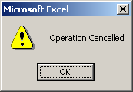
Dialodlogs (4)

Slide 18

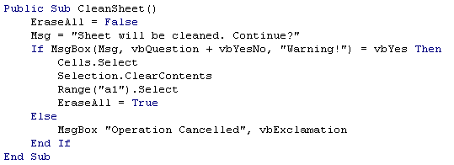
Apmaiņa ar datiem

Slide 19
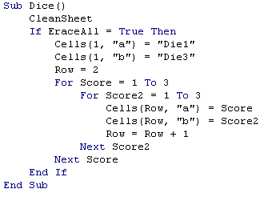
Apmaiņa ar datiem (2)

Slide 20
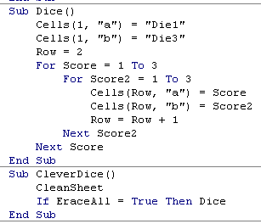
Apmaiņa ar datiem (3)

Slide 21
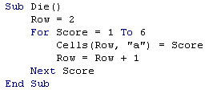
Ievaddati
Ievest

Slide 22

Ievaddati (2)

Slide 23
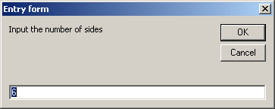
Ievaddati (2)

Slide 24
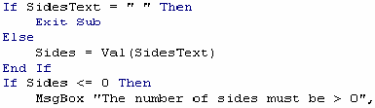
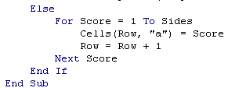
Ievaddati (3)

Slide 25
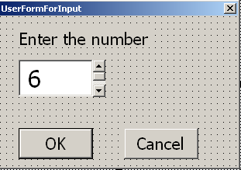
Pieskaņots dialoga lodziņš (User Form)
Piemērs, pamatots uz makro (die)

Slide 26
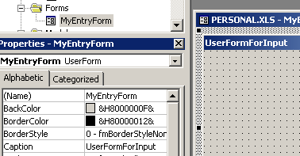
User Form (2)
1. Solis – veidot lietotāja formu
Alt+F11 / Insert / User Form / Properties: / Name: MyEntryForm / Caption: UserFormForInput

Slide 27
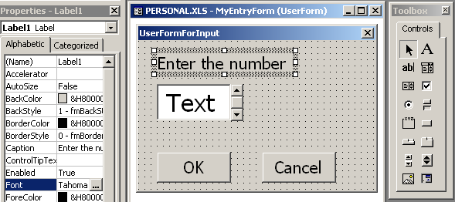
User Form (3)
2. Solis – pievienot vadības

Slide 28
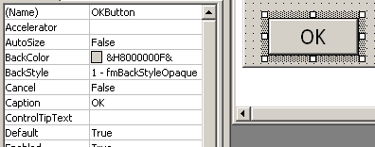
User Form (4)
3. Solis – noteikt vadības īpašības
Name:OKButton / Caption:OK / Default:True

Slide 29



User Form (5)
3. Solis – noteikt vadības īpašības (2)
Name:CancelButton / Caption:Cancel
Name:EntryBox
Name:SpinButton / Max:6 / Min:1

Slide 30
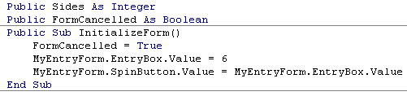
User Form (6)
4. Solis – inicializēt vadības
Windows / Module 1 (Code)

Slide 31
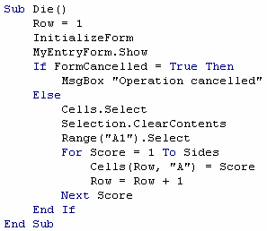
User Form (7)
5. Solis – pielietot formu

Slide 32
User Form (8)
5. Solis – pielietot formu (2)

Slide 33
User Form (9)
5. Solis – pielietot formu (3)

Slide 34
User Form (9)
5. Solis – pielietot formu (4)

Slide 35

User Form (10)
6. Solis – notikumu operācijas
Windows / MyEntryForm (UserForm)
DoubleClick -> MyEntryForm (Code):
Private Sub OKButton_Click()
End Sub
operācijas

Slide 36


User Form (11)
6. Solis – notikumu operācijas (2)

Slide 37



User Form (12)
6. Solis – notikumu operācijas (3)

Slide 38

User Form (13)
6. Solis – notikumu operācijas (4)

Slide 39
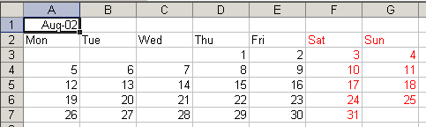
Kalendārs (2. Excela uzdevums)
2002. g. Augusts
Record New Macro (Relative reference)
Macro name: Macro1

Slide 40
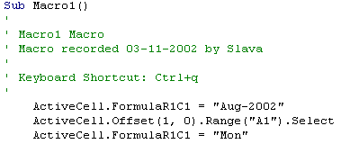
Kalendārs (2)
ActiveCell.Offset(0, 1).Range("A1").Select
ActiveCell.FormulaR1C1 = "Tue"

Slide 41

Kalendārs (3)
…
Selection.Font.ColorIndex = 3
ActiveCell.FormulaR1C1 = "Sat"
…
ActiveCell.Offset(1, -3).Range("A1").Select ActiveCell.FormulaR1C1 = "1"
…
ActiveCell.Offset(1, -6).Range("A1").Select ActiveCell.FormulaR1C1 = "5“
…
ActiveCell.FormulaR1C1 = "31"
ActiveCell.Offset(-6, -5).Range("A1").Select
End Sub

Slide 42

Kalendārs (4)
Sub Macro2()
StartRow = ActiveCell.Row
StartColumn = ActiveCell.Column
Cells(StartRow, StartColumn) = "Aug-02"
Cells(StartRow + 1, StartColumn) = "Mon"
Cells(StartRow + 1, StartColumn + 1) = "Tue"
Cells(StartRow + 1, StartColumn + 2) = "Wed"
Cells(StartRow + 1, StartColumn + 3) = "Thu"
Cells(StartRow + 1, StartColumn + 4) = "Fri"
Cells(StartRow + 1, StartColumn + 5) = "Sat"
Cells(StartRow + 1, StartColumn + 6) = "Sun"
ActiveCell.Offset(2, 3).Range("A1").Select
ActiveCell.FormulaR1C1 = "1"
…

Slide 43
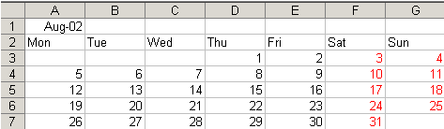
Kalendārs (5)

Slide 44
Kalendārs (6)
…
Cells(StartRow + 1, StartColumn + 6) = "Sun"
DayNumber = 1
StartDay = 3
For WeekofMonth = 0 To 5
For DayofWeek = StartDay To 6
Cells(StartRow + 2 + WeekofMonth, StartColumn + DayofWeek) = DayNumber
DayNumber = DayNumber + 1
Next DayofWeek
StartDay = 0
Next WeekofMonth
End Sub

Slide 45
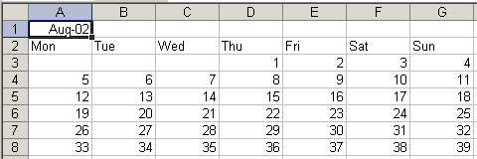
Kalendārs (7)

Slide 46
Kalendārs (8)
For WeekofMonth = 0 To 5
For DayofWeek = StartDay To 6
If DayNumber < 32 Then
Cells(StartRow + 2 + WeekofMonth, StartColumn + DayofWeek) = DayNumber
End If
DayNumber = DayNumber + 1
Next DayofWeek
StartDay = 0
Next WeekofMonth
ActiveCell.Offset(1, 5).Range("A1:B6").Select
Selection.Font.ColorIndex = 3
ActiveCell.Offset(-1, -5).Range("A1").Select
End Sub

Slide 47
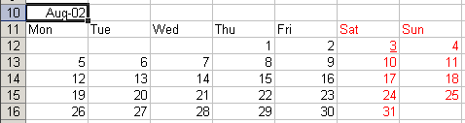
Kalendārs (9)
Tikai 2002. gada augusts !

Slide 48
Kalendārs (10)
Public Sub Macro3()
YearNumber = "2002"
NameofMonth = "August"
…
Cells(StartRow, StartColumn) = NameofMonth & "-" & YearNumber
…
StartDay = Weekday("1-" & NameofMonth & "-" & YearNumber, vbTuesday)
…
Tuesday – 1
Wednesday – 2
Thursday - 3

Slide 49
Kalendārs (11)
Public Sub Macro3()
YearNumber = "2003"
NameofMonth = “November"
…
Cells(StartRow, StartColumn) = NameofMonth & "-" & YearNumber
…
StartDay = Weekday("1-" & NameofMonth & "-" & YearNumber, vbTuesday)
…
If DayNumber < 32 Then
...
Jeb kurš gads
Jeb kurš mēnesis
Kļūda !

Slide 50
Kalendārs (12)
Public Sub Macro3()
...
NameofMonth = ...
If NameofMonth = “January” or NameofMonth = “March” ... or NameofMonth = “December” then LastDay= 31
If NameofMonth = “April” or NameofMonth = “June” ... or NameofMonth = “November” then LastDay= 30
…
If DayNumber <= LastDay Then
...
Jeb kurš gads
Jeb kurš mēnesis

Slide 51
Kalendārs (13)
StartDay = Weekday("1-" & NameofMonth & "-" & YearNumber, vbTuesday)
Tuesday – 1
...
Sunday – 6
Monday - 7
Kļūda !
For DayofWeek = StartDay To 6

Slide 52
Kalendārs (14)
Dim YearNumber As String
Dim NameofMonth As String
Public Sub Macro4()
YearNumber = "2002"
NameofMonth = "August"
Macro3
End Sub
Public Sub Macro3()
...
Cells(StartRow, StartColumn) = NameofMonth & "-" & YearNumber
…

Slide 53
Kalendārs (15)
Public YearNumber As String
Public NameofMonth As String
...
Public Sub Macro5()
InitializeForm
MyEntryForm.Show
Macro3
End Sub

